Slide 1

Introduction to JOINS
Infoway Technologies, 3rd Floor Commerce Centre, Rambaug Colony, Paud Road Pune 411038

Slide 2
Introduction to JOINS
The SQL Joins clause is used to combine records from two or more tables in a database. A JOIN is a means for combining fields from two tables by using values common to each.
Infoway Technologies, 3rd Floor Commerce Centre, Rambaug Colony, Paud Road Pune 411038

Slide 3
need of JOINS
JOINS are used to retrieve data from multiple tables.
JOIN is performed whenever two or more tables are joined in a SQL statement.
Infoway Technologies, 3rd Floor Commerce Centre, Rambaug Colony, Paud Road Pune 411038

Slide 4
types of JOINS
Types of JOINS
Cartesian or Product Join – Cross Join
Equijoin – Inner Join
Natural Join
Outer Join – Right Outer Join, Left Outer Join
Self Join
Infoway Technologies, 3rd Floor Commerce Centre, Rambaug Colony, Paud Road Pune 411038

Slide 5
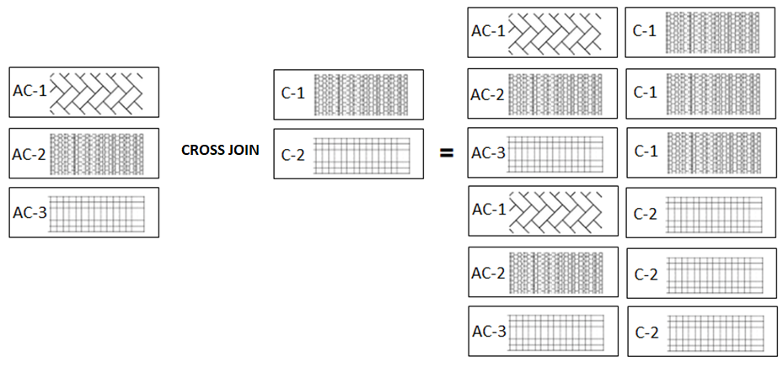
cartesian, product / cross join
Cartesian or Product joins are joins without a join condition. Each row of one table is combined with each row of another table. The result is referred to as a Cartesian product.
Infoway Technologies, 3rd Floor Commerce Centre, Rambaug Colony, Paud Road Pune 411038

Slide 6
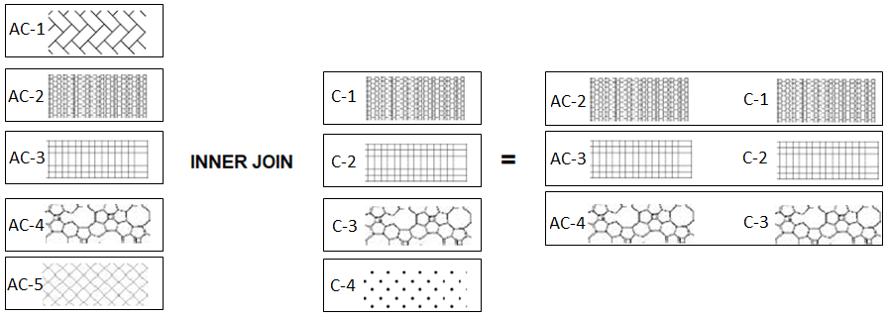
inner / equi join
EQUI JOIN performs a JOIN against equality or matching column(s) values of the associated tables. An equal sign (=) is used as comparison operator in the where clause to refer equality.
EQUI join returns rows when there is at least one match in both tables.
Infoway Technologies, 3rd Floor Commerce Centre, Rambaug Colony, Paud Road Pune 411038

Slide 7
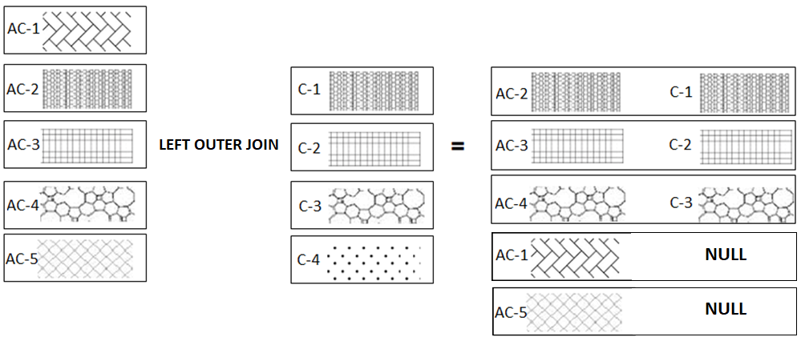
left outer join
The LEFT JOIN keyword returns all rows from the left table (table1), with the matching rows in the right table (table2). The result is NULL in the right side when there is no match.
Infoway Technologies, 3rd Floor Commerce Centre, Rambaug Colony, Paud Road Pune 411038

Slide 8
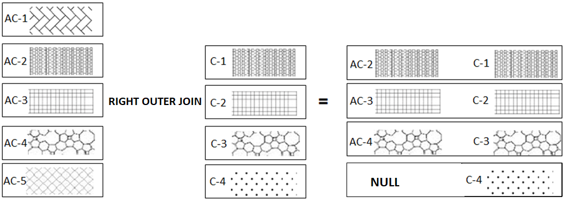
right outer join
The RIGHT JOIN keyword returns all rows from the right table (table2), with the matching rows in the left table (table1). The result is NULL in the left side when there is no match.
Infoway Technologies, 3rd Floor Commerce Centre, Rambaug Colony, Paud Road Pune 411038

